Slide 1
Electricity Markets: Basics and operation
Presented by: Guided by:
Shreeram Kumar (2302052) Dr. Saran Satsangi
Akash Singh (2302053) Dr. Ajishek Raj
Himanshu Yadav (2302054)

Slide 2
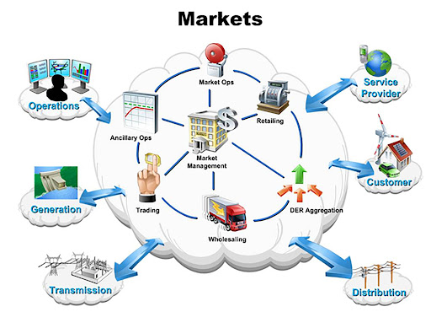
Introduction
Electricity markets are structured systems that enable the production, trading, and consumption of electricity in an efficient and reliable manner.
These markets are designed to balance supply and demand in real-time, ensuring that electricity is delivered to consumers when and where it is needed.
Figure 1 : Components of electricity market

Slide 3
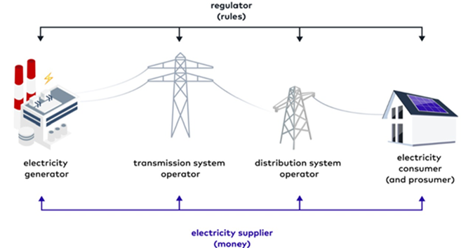
Market Participants
Generators :- Companies or government entities that produce electricity from coal, hydro, solar, wind, and nuclear sources. Examples: NTPC, Tata Power, Adani Power, ReNew Power, NHPC.
Transmission System Operators:- Responsible for transporting electricity from power plants to different states and regions. In India, this is managed by Power Grid Corporation of India Limited (PGCIL) and State Transmission Utilities (STUs).
Figure 2 : Market Participants

Slide 4
Distribution System Operators:- Deliver electricity to homes, offices, and industries. These include state electricity boards and private DISCOMs like Tata Power, BSES, and Torrent Power.
Retailers :-Companies that sell electricity to consumers. In India, most states have only one electricity provider per region, so retail competition is limited.
Consumers:-They are ones who actually uses electricity. Households, factories, shops, malls, hospitals, and farms are some major consumers . Some consumers also become prosumers by generating electricity (e.g., through solar panels) and selling surplus power to the grid
Generators produces power
TSOs transport it
DSOs distribute it
Retailers sell it
Consumers uses it
Fig3. Flow chart of participants

Slide 5
Market Models
The three primary models are regulated markets, deregulated markets, and hybrid markets.
Regulated Markets:- Electricity is generated, transported, and sold by government-owned companies, and prices are fixed by regulators like the Central Electricity Regulatory Commission (CERC) and State Electricity Regulatory Commissions (SERCs).
Deregulated Markets:- India has started moving towards a more competitive electricity market.Power generators can now sell electricity in open markets instead of only selling to government DISCOMs. Big consumers (factories, malls, IT companies) can buy electricity directly from private generators at competitive prices through a system called Open Access.
Hybrid Markets:-mix of both regulated and deregulated systems. Some parts, like transmission and distribution, remain government-controlled, while generation and trading are open to competition.

Slide 6
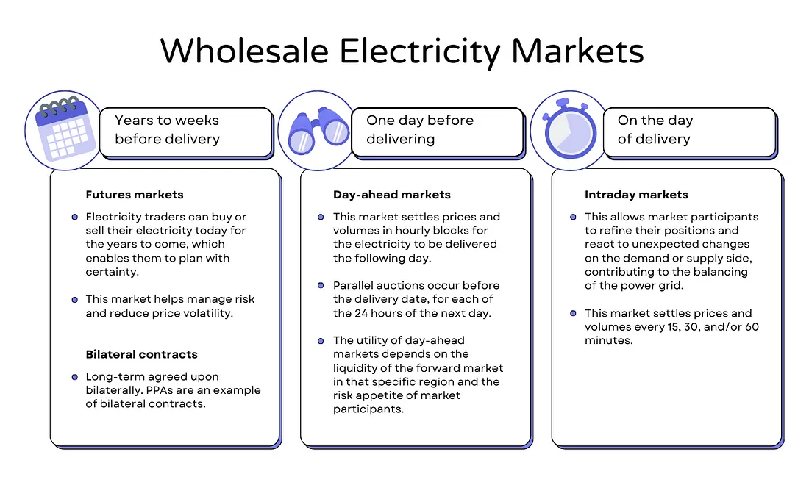
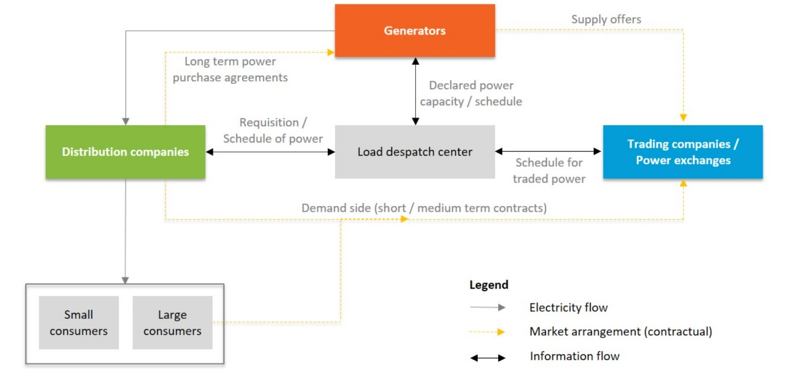
Market Types
Wholesale Market:- In this market electricity is bought and sold in bulk. It's also known as a power exchange (PX) or energy exchange.
Retail Market:- A retail electric market consists of utility companies, local power lines, retail energy suppliers, retail energy brokers, energy consultants, energy traders, and ultimately energy consumers.
Figure 4 : Wholesale market structure

Slide 7
Market Mechanism and Pricing
Pricing of electricity is determined based on supply and demand.
Three main pricing mechanisms are:-
Marginal Pricing:-Price is determined on the basis of the most expensive generator needed to meet demands.
Pay-as-Bid Pricing:-Price is determined on the basis of individual generator bids.
Capacity Market:-Price is determined on the basis of long-term contracts and centralized planning.

Slide 8
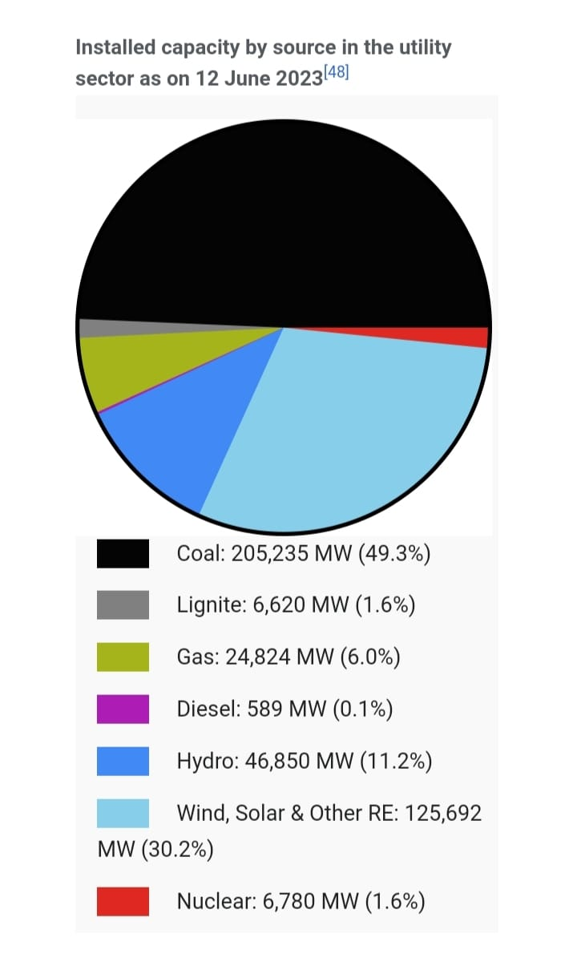
Challenges in Electricity Market
Low utilization of generation capacity due to shortage of fuel and unviable power purchase agreements.
Limited storage capacity of renewable resources.
Irregularities in power generation by renewable resources.
Figure 5 : Electricity generation capacity

Slide 9
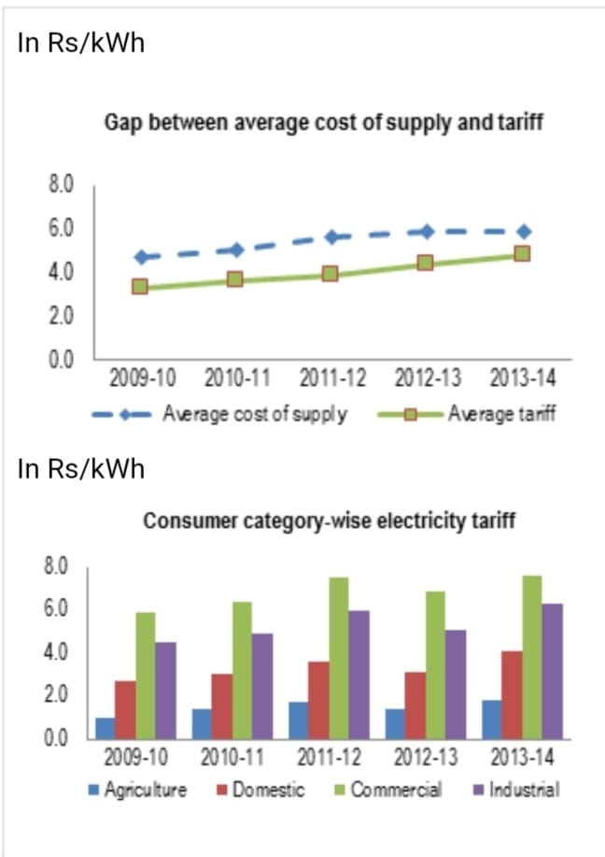
Dominance of state-owned power distribution companies
Supplying electricity at tariffs lower than the cost of supply due to government subsidies.
Unpredictable load pattern.
Figure 6: Data regarding electricity tariffs

Slide 10
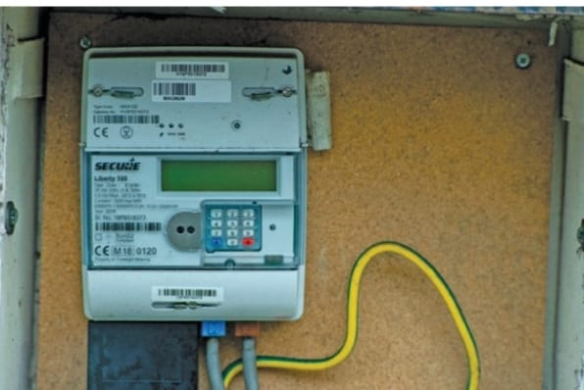
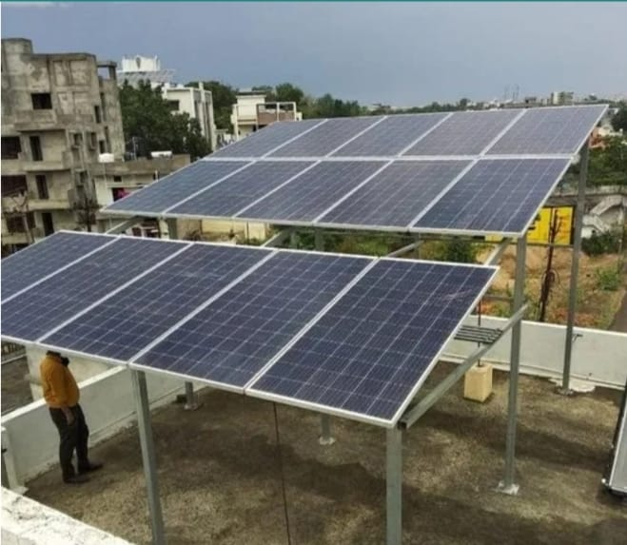

Innovations and Trends
Deployment of smart meters under Revamped Distribution Sector Scheme (RDSS).
Battery Energy Storage Systems (BESS) for excess renewable power.
Introduction of Electric Vehicles (EVs) transform electricity demand patterns.
Adoption of rooftop solar panels from residential and commercial consumers.
Exploring blockchain for transparent and efficient energy trading and tracking.
Figure 7: Innovations and trends

Slide 11


Future of Electricity Market
Expansion of renewable energy resources.
Reducing dependency on thermal power plants.
Upgrade in charging infrastructure for electric vehicles.
AI driven advanced grid management.
Globalization of electricity market.
Concept of Peer-to-Peer (P2P) energy trading.
Figure 8: Future of electricity markets

Slide 12
Conclusion
In conclusion, electricity markets play a crucial role in ensuring the efficient generation, distribution, and consumption of electricity. By leveraging competitive pricing mechanisms, market structures such as wholesale and retail markets help balance supply and demand while promoting innovation and sustainability.
However, challenges such as overdependency on non-renewable resources , unpredictable load pattern require ongoing adaptation and strategic planning. We further talks about the innovations and trends which were ongoing in the electricity market sectors and also predicts the future of electricity market.

Slide 13


